Slide 1
Yelp Sandwiches Analysis
Group 5:
Shuren He
Ziyue Zheng
Ouyang Xu

Slide 2
Category
Scores analysis
Reviews analysis
Shiny App

Slide 3
Data summary
Score distribution in different seasons
We already have a preliminary understanding of the data in the previous report
We want to further explore whether there are differences in ratings between seasons
 | Spring | Summer | Fall | Winter
Mean | 3.691 | 3.695 | 3.677 | 3.707
Std | 1.387 | 1.394 | 1.405 | 1.382

Slide 4
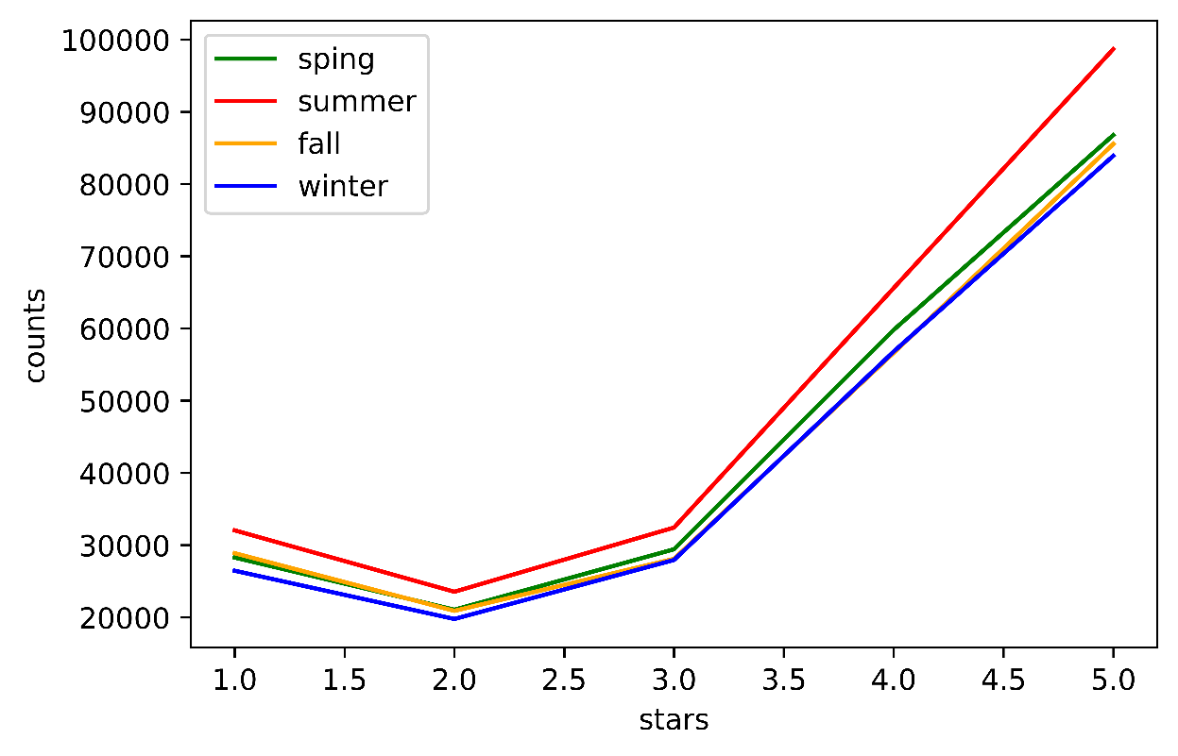
Statistical analysis
Score distribution in different seasons
We can see there overall shapes are quite similar between seasons.
Due to the large scale, differences really exist.

Slide 5
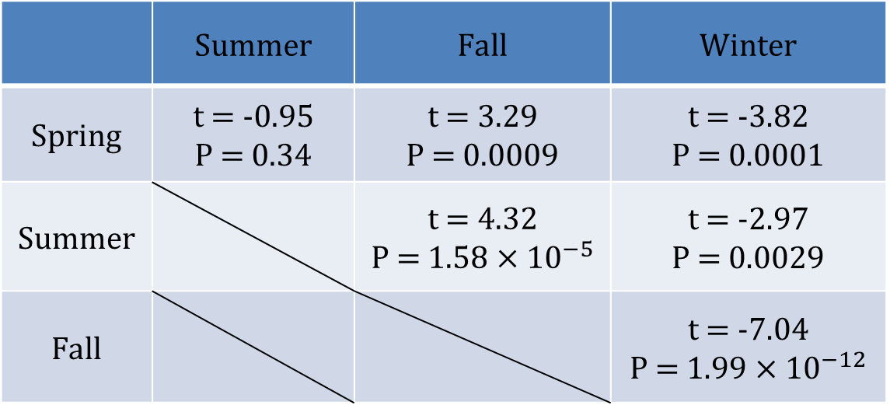
Statistical analysis
t-test table
 | Summer | Fall | Winter
Spring | t = -0.95 P = 0.34 | t = 3.29 P = 0.0009 | t = -3.82 P = 0.0001
Summer |  | t = 4.32 P = $1.58×{10}^{−5}$ | t = -2.97 P = 0.0029
Fall |  |  | t = -7.04 P = $1.99×{10}^{−12}$
The spring and summer have no difference
Winter has the highest average scores and Fallhas the lowest

Slide 6
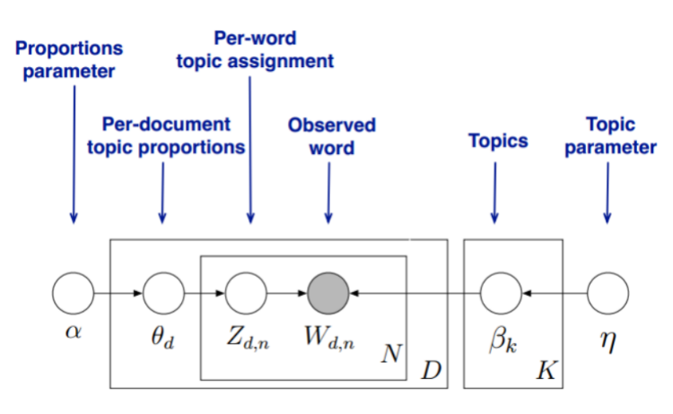
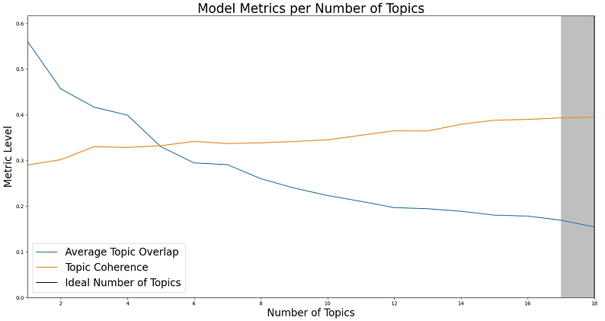
LDA Topics model
LDA is used to classify text in a document to a particular topic.
It is a kind of unsupervised clustering model.

Slide 7
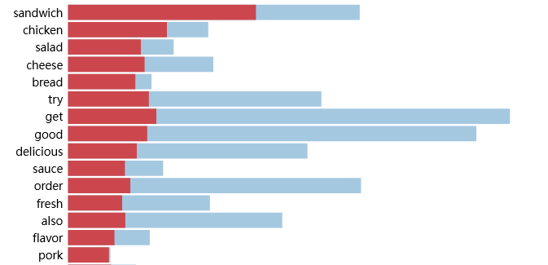
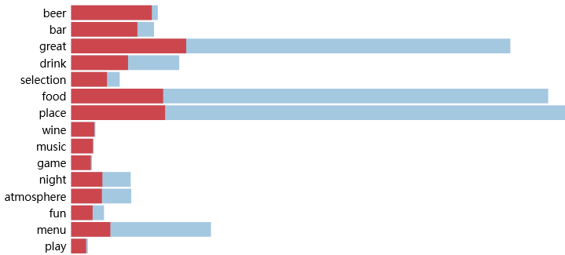
LDA analysis
01
Key words
LDA model will give the key words with in each topic
02
Topic summary
Summarize the topics manually with key words

Slide 8
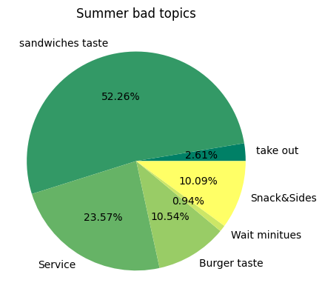
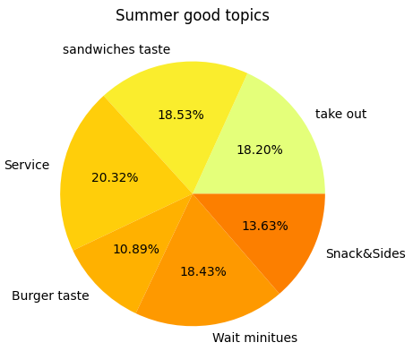
LDA analysis
An example of summer
Positive reviews are relatively evenly distributed
Negative reviews mainly focus on the sandwich taste and service.

Slide 9
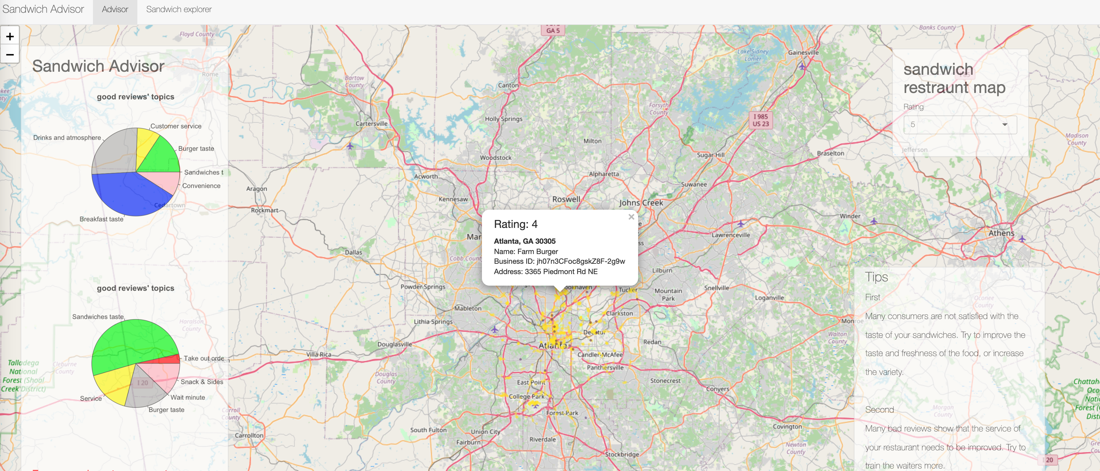
Shiny App
https://ouyangxu.shinyapps.io/YelpShiny/

Slide 10
THANK YOU

